Slide 1



Mini Project 2 Time series Forecasting
Forecasting sales for The Officebox department store
Faiyaz Bhanji

Slide 2
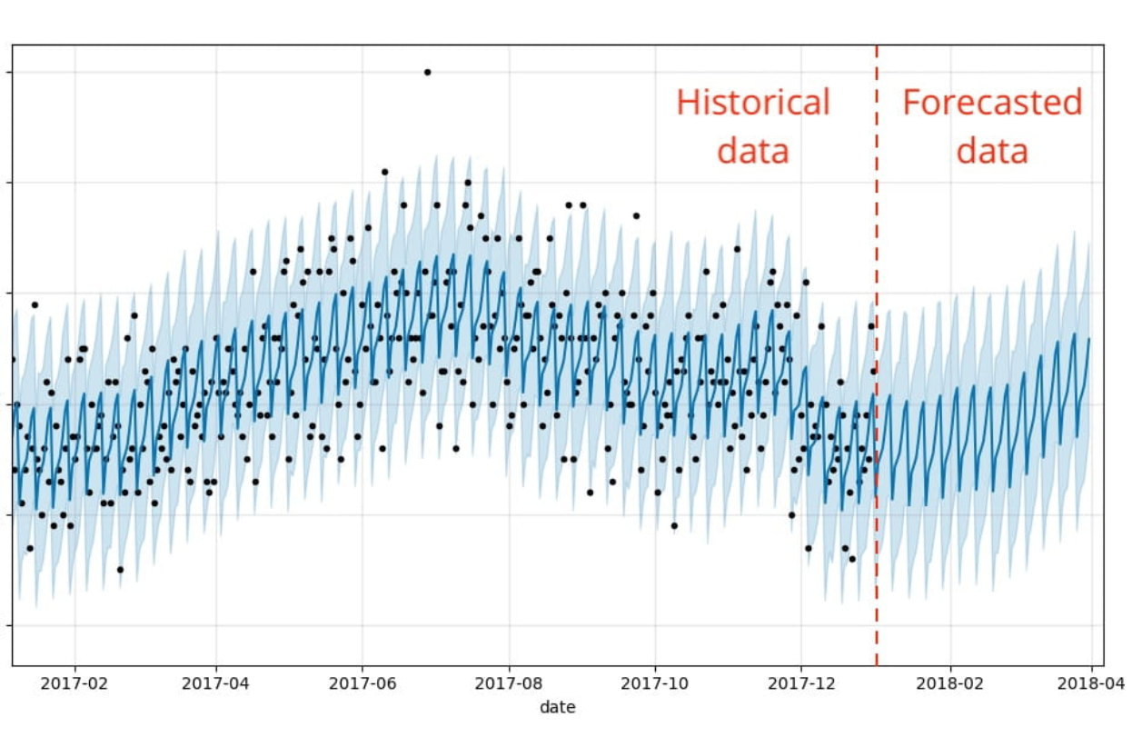
Careful planning puts you ahead in the long run
Machine learning model to forecast sales given enough historical data.
New Statistical methods and advances in Machine learning techniques can allow us to do this. So why not take advantage?
My name is Faez and we’re here to discuss the sales forecasting model that my team and I have developed for you.
I know that todays discussion may bring up a number of questions from you and I want to let you know that I will address as many as I can in the time that we have today.

Slide 3
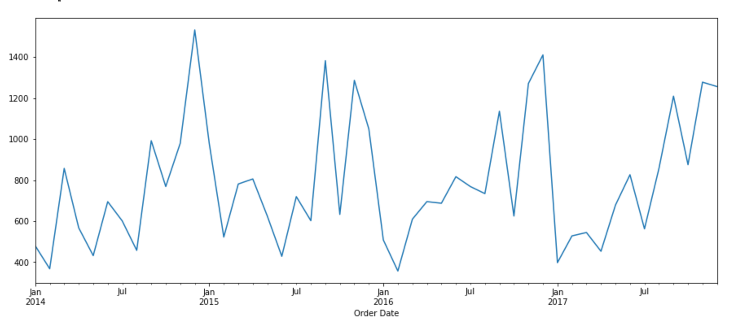
The current iteration of the forecasting model, takes only two categories into consideration, Furniture and Office Supplies.
Here you are looking at the actual sales figures for Officebox department store, by Order date from 2014 to 2017.
The data points are showing the daily average for the Month.
You can see the basic up and down patterns, and you get a general sense of the data
As you can see there aren’t any very strange anomalies; neither are there any red flags or obvious quality issues.
You can clearly see a seasonal pattern in the data to date.

Slide 4
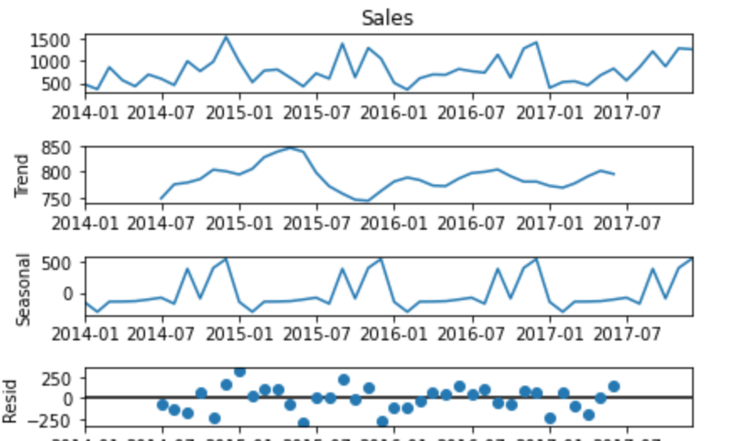
The previous chart indicates to us that there may be other patterns hidden within this data. This figure shows these hidden patterns
The data has seasonality such as the sales are low at the beginning of the year and high at the end of the year.
There is also always an upward trend within any single year with a couple of low months in the middle of the year.
The sales for furniture is unstable

Slide 5
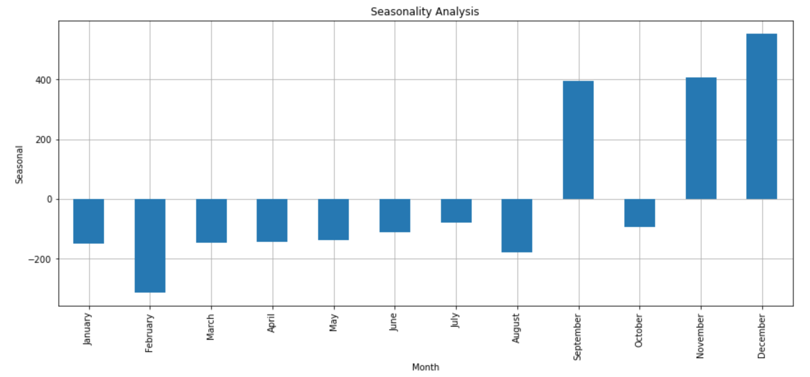
Seasonality Analysis
As you can see from this bar chart, there is obvious seasonal variation hidden within the data.
It depicts the seasonal pattern in the data stay roughly the same over time and don’t fluctuate in relation to the overall data.

Slide 6
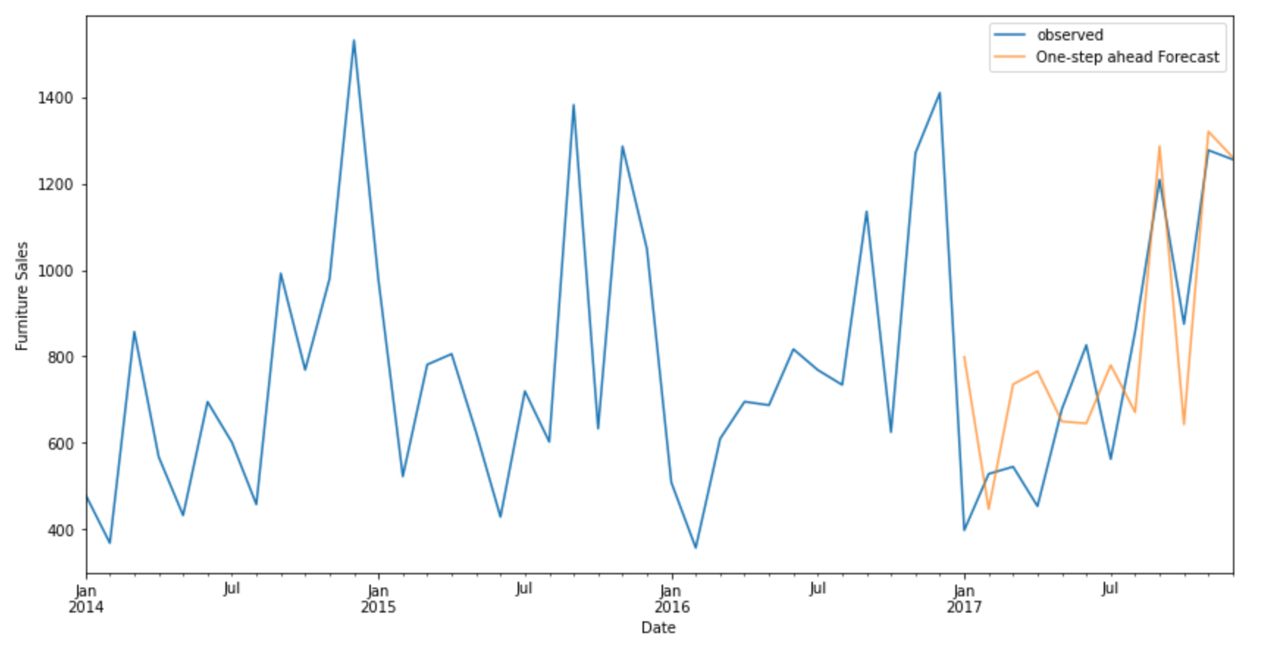

Actual vs Observed
This chart shows the validation results of our model’s forecast.
To check the accuracy of our forecasting model, we got the model to run a forecast for 2017 and compared this with the actual sales for 2017. You can see the forecast –in orange-overlaid on the actuals.
As you can see the forecast aligns with the actual values showing an upward trend from the start of the year and the seasonality pattern nearing the end of the year.
The RMSE of our model is 155. In Statistics the MSE is a measure of the quality of our forecasts. It tells us that our model was able to forecast the average daily furniture sales in the test set within 155 of the real sales. Considering that the current furniture daily sales ranges to over 1200, In my opinion, this is a pretty good model.

Slide 7
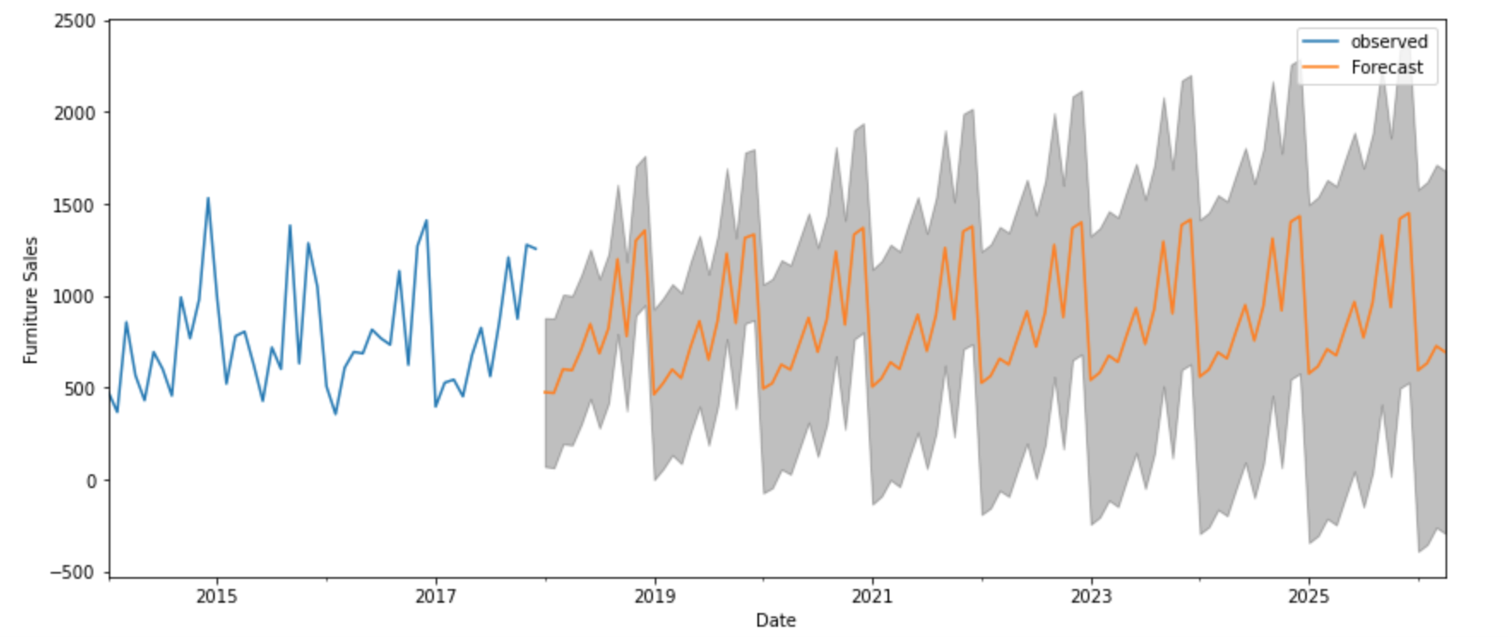
Predictions and Forecasting
The results of the forecasting model should not be seen as a guaranteed or expected result. But rather as a reference that provides a general picture of the yearly pattern.
We used our forecasting model to forecast sales from 2018 – 2025. This chart shows the forecast.
The orange line shows the average forecasted value for each month. The grey area represents the 95% confidence interval. This means we are 95% confident the actual sales will fall within this range. As with real life the further into the future we predict the less confidence we’ll have in our prediction

Slide 8
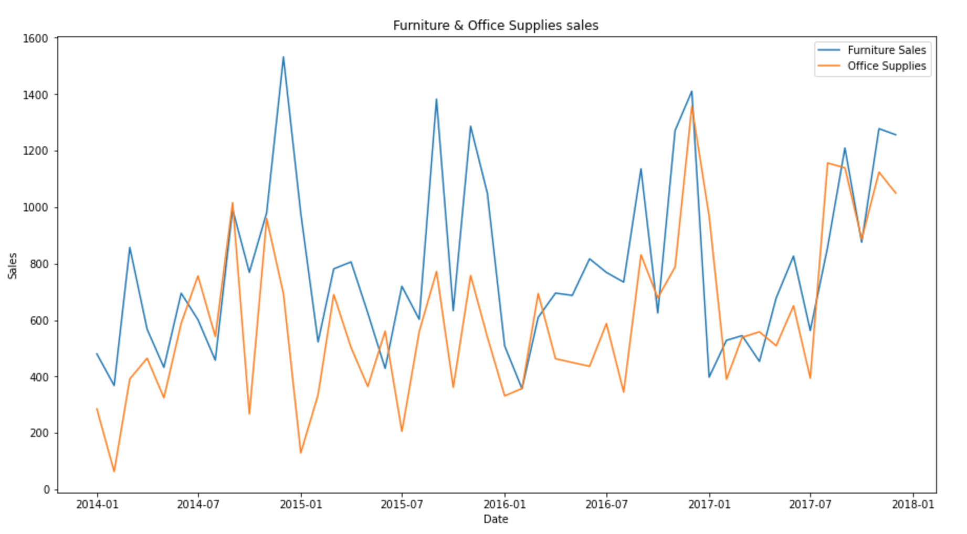
Office Supplies category with Furniture
Our initial inspection of the data showed that there were more number of sales for office supplies than there were for furniture. Furniture had 2121 number of sales and Office supplies had 6026 number of sales.
Our model shows, that the sales for furniture and office supplies both share a similar seasonal pattern. This can be seen visually in this chart.
Early on in the year is a quiet period for both categories, which then picks up as we approach the end of the year. Furthermore average daily sales for furniture are higher than those of office supplies in most of the months. It is understandable, as the value of furniture should be much higher than those of office supplies. Occasionally, office supplies passed furniture on average daily sales.

Slide 9
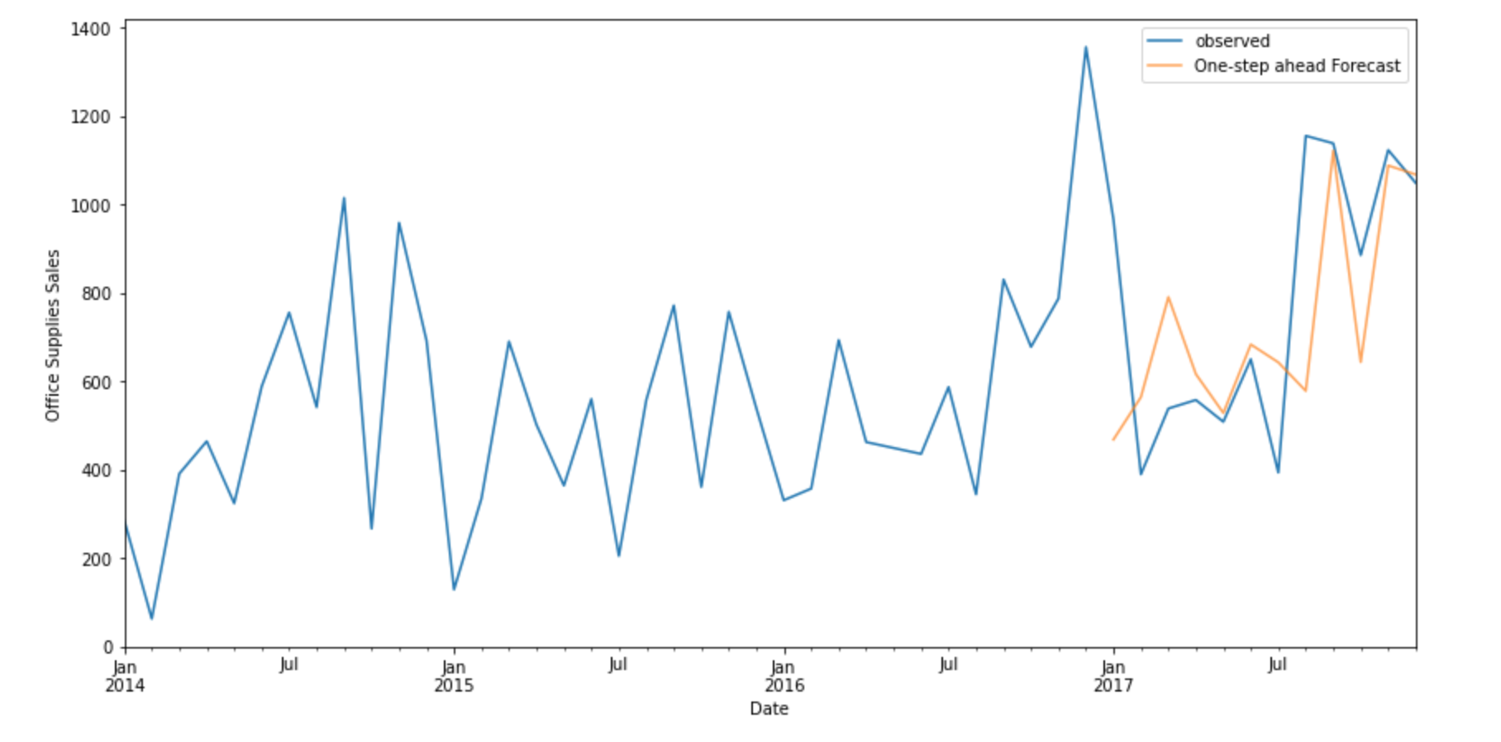
Forecasting Office Supplies
We did the same forecasting with Office supplies, and to check the accuracy of our model, we ran a forecast for 2017, then compared this with the actual sales for 2017. You can see the forecast overlaid on the actuals in this chart. The blue line shows the actual sales for office supplies and the orange the forecasted values. As you can see the forecast aligns with the actual values showing an upward trend from the start of the year and the seasonality pattern nearing the end of the year.

Slide 10
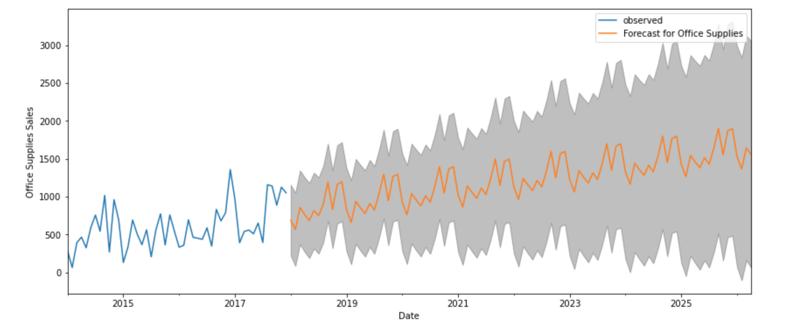
Forecasting into the future; What the future holds for Office Supplies
This is the forecast for office supplies from 2018 - 2025
The orange plot shows the predicted values for each month and the blue is showing the actual sales
The grey area represents the 95% confidence interval. This means we are 95% confident the actual sales will fall within this range. As with real life the further into the future we predict the less confidence we’ll have in our prediction

Slide 11
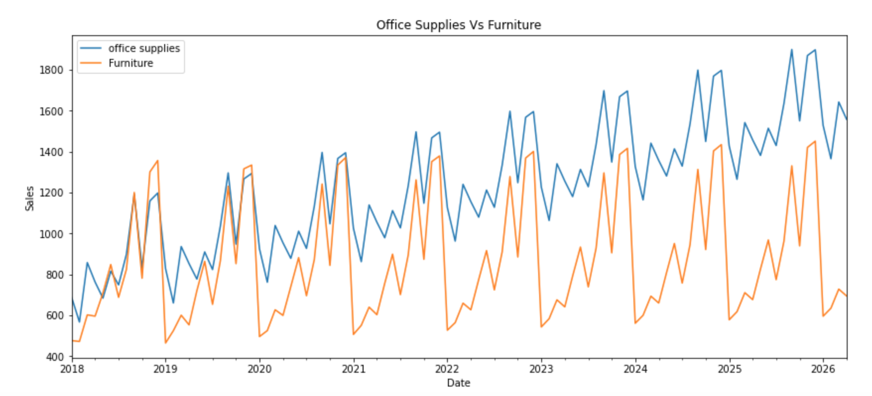
Office Supplies Vs Furniture 2018 - 2025
We joined the forecasts for both the categories and came up with this.
The orange line is showing the results of the furniture category from 2018 to 2025 and the blue for furniture.
Both have an upward trend and both have a similar seasonal pattern.

Slide 12

How you will incorporate this model into your planning strategies
What aspects of the business can be improved . Forecasting can indicate when best to hold promotions and sales
Workfore can be adjusted based on forecasting results. Less staff quiet time, more staff during busy time
Update model to
Include the Technology category
Forecast via store
Forecast cycle Monthly to quaterly or even weekly
Drill down to a sub-category to find good performing products
There are additional tools to simplify and enhance the model’s predictions, and some other external data could also be used in this regard

